Slide 1
Web Servers

Slide 2
What Is A Web Server?
Hardware or software
Delivers content in form of web pages
Usually using HTTP
Usually hosts multiple sites
Content delivered to a user agent
May support ‘server-side scripting’
Can be embedded in devices such as printers, routers, etc
Notes:
A web server is hardware and software that delivers contents to clients in the form of web pages. A web browser usually uses HTTP and hosts multiple web sites. A web server can support server side scripting and can be embedded into devices such as printers or routers.

Slide 3
Before Web
1980s – Internet was there, but only people connected were big corporations and educational institutions
Most networks were centralized and proprietary
Problems
Sharing difficult as big messages would cause delays (until packet switching)
Proprietary meant that networks could not talk to each other (until open protocols such as HTTP and TCP/IP)
Centralized meant that single points of failure were possible. If ‘hub’ or server went down everyone was down

Slide 4
Client/Server Paradigm
Servers wait for requests to arrive
Clients send requests for information
Servers process the requests and send back information
Clients can be other servers that need information
Client and server usually on separate machines, but can be on the same machine
Notes:
Client/Server paradigm
Server

Slide 5
Client/Server Communications
Request-response interactions
Client says it has a request
Server acknowledges it is there
Client sends commands on a line by line basis
Server responds to commands
Notes:
SMTP [HELO] initiates
[DATA] starts a block that ends with a single period on the line

Slide 6
Stateless vs. Stateful
Stateful protocol (e.g. SMTP)
Maintains the state between specific commands
Server must maintain the “state” between successive commands until the connection is terminated
Sequence of commands is called a session
Stateless protocol (e.g. HTTP)
Single command and single response
Does not know what previous requests were
Notes:
SMTP – Simple Mail Transfer Protocol
http://utcc.utoronto.ca/usg/technotes/smtp-intro.html
SMTP is the Internet protocol used to transfer electronic mail between computers
HTTP – Hypertext transfer protocol
From wiki:
The Hypertext Transfer Protocol (HTTP) is an application protocol for distributed, collaborative, hypermedia information systems.^{[1]}HTTP is the foundation of data communication for the World Wide Web.
Hypertext is structured text that uses logical links (hyperlinks) between nodes containing text. HTTP is the protocol to exchange or transfer hypertex
But what does this really mean???
http://www.webopedia.com/TERM/H/HTTP.html
HTTP defines how messages are formatted and transmitted, and what actions Web servers and browsers should take in response to various commands. For example, when you enter a URL in your browser, this actually sends an HTTP command to the Web server directing it to fetch and transmit the requested Web page.
The other main standard that controls how the World Wide Web works is HTML, which covers how Web pages are formatted and displayed.
What does SMTP stand for?
What is it used for?
What does HTTP stand for?
What is it used for?
From wiki: The Hypertext Transfer Protocol (HTTP) is an application protocol for distributed, collaborative, hypermedia information systems.[1]HTTP is the foundation of data communication for the World Wide Web. Hypertext is structured text that uses logical links (hyperlinks) between nodes containing text. HTTP is the protocol to exchange or transfer hypertext What does this really mean?
Explain in more detail what a stateful protocol is.
Explain in more detail what a stateless protocol is and compare it to a stateful one (adv and disadv.)

Slide 7
Communicating Using TCP/IP
Client program opens a socket
(a connection between the machines)
Servers are listening on specific ports
Port is NOT physical, just a numeric reference within a request that specifies which server program is supposed to get the message
Three types: well known, registered and dynamic or private
SMTP – 25; SSL – 443; HTTP – 80
Notes:
Show video on how from wimp
http://www.wimp.com/internetworks/
What does TCP/IP stand for? (Transmission Control Protocol) full duplex = bidirectional travel
What are port numbers and how do they work?
http://compnetworking.about.com/od/networkprotocols/f/port-numbers.htm
A port number is part of the addressing information used to identify the senders and receivers of messages.
Port numbers work like telephone extensions. Just as a business telephone switchboard can use a main phone number and assign each employee an extension number (like x100, x101, etc.), so a computer has a main address and a set of port numbers to handle incoming and outgoing connections.
What are the 3 categories of port numbers?
List 10 port numbers of each (that are familiar to you) and what they are used for. Look them up – what
Well known – 0 – 1023 = They are used by system processes that provide widely used types of network services
http://searchnetworking.techtarget.com/definition/well-known-port-numbers
Each kind of application has a designated (and thus "well-known") port number. For example, a remote job entry application has the port number of 5; the Hypertext Transfer Protocol (HTTP) application has the port number of 80; and the Post Office Protocol Version 3 (POP3) application, commonly used for e-mail delivery, has the port number of 110. When one application communicates with another application at another hostcomputer on the Internet, it specifies that application in each data transmission by using its port number.
Registered – 1024 – 49151 = They are assigned by IANA for specific service upon application by a requesting entity.^{[1]} On most systems, registered ports can be used by ordinary users. What is IANA? – Is it international and profit or non-profit? The Internet Assigned Numbers Authority (IANA) is responsible for the global coordination of the DNS Root, IP addressing, and other Internet protocol resources
“The Internet Assigned Numbers Authority (IANA) is a department of ICANN (Internet Corporation for Assigned Names and Numbers)responsible for coordinating some of the key elements that keep the Internet running smoothly. Whilst the Internet is renowned for being a worldwide network free from central coordination, there is a technical need for some key parts of the Internet to be globally coordinated, and this coordination role is undertaken by IANA.
Specifically, IANA allocates and maintains unique codes and numbering systems that are used in the technical standards (“protocols”) that drive the Internet.”
Dynamic – 49152 – 65535 - contains dynamic or private ports that cannot be registered with IANA.^{[162]} This range is used for custom or temporary purposes and for automatic allocation of ephemeral ports.
FTP – 21; Telnet – 23; NNTP – 119; DNS – 53; SSL – 443
What does TCP/IP stand for?
What are port numbers and how do they work?
What are the 3 categories of port numbers and what are they generally used for (why are they categorized into 3 groups)?
List 10 port numbers of each (that are familiar to you) and what they are used for.
What is IANA and what is it responsible for? Is it international? Is it profit or non-profit?

Slide 8
Security and Encryption
By default data is sent as plain text
“Packet sniffer” on the line to read the text
Packet switching makes that more difficult, but still possible
Secure Shell (SSH) is secure
1024 or 2048 bit encryption
2 “keys” generated
A public key by the host
A private key by the client which is unique
When they talk they exchange keys
Notes:
Show video on how from wimp
http://www.wimp.com/howencryption/
Packet sniffer??
http://computer.howstuffworks.com/workplace-surveillance2.htm
a packet sniffer is a program that can see all of the information passing over the network it is connected to. As data streams back and forth on the network, the program looks at, or "sniffs," each packet. A packet is a part of a message that has been broken up.
Why does packet switching make it more difficult?
Symmetric encryption vs asymmetric http://www.digicert.com/ssl-cryptography.htm
RSA?? - RSA is based on the presumed difficulty of factoring large integers (integer factorization). Full decryption of an RSA ciphertext is thought to be infeasible on the assumption that no efficient algorithm exists for integer factorization.
A user of RSA creates and then publishes the product of two large prime numbers, along with an auxiliary value, as their public key. The prime factors must be kept secret. Anyone can use the public key to encrypt a message, but only someone with knowledge of the prime factors can feasibly decode the message.
RSA stands for Ron Rivest, Adi Shamir, and Leonard Adleman— the men who first publicly described the algorithm in 1977.
SSH and keys
https://wiki.archlinux.org/index.php/SSH_keys
SSH keys always come in pairs, one private and the other public. The private key is known only to you and it should be safely guarded. By contrast, the public key can be shared freely with any SSH server to which you would like to connect.
When an SSH server has your public key on file and sees you requesting a connection, it uses your public key to construct and send you a challenge. This challenge is like a coded message and it must be met with the appropriate response before the server will grant you access. What makes this coded message particularly secure is that it can only be understood by someone with the private key. While the public key can be used to encrypt the message, it cannot be used to decrypt that very same message. Only you, the holder of the private key, will be able to correctly understand the challenge and produce the correct response.
This challenge-response phase happens behind the scenes and is invisible to the user. As long as you hold the private key, which is typically stored in the ~/.ssh/ directory, your SSH client should be able to reply with the appropriate response to the server.
Because private keys are considered sensitive information, they are often stored on disk in an encrypted form. In this case, when the private key is required, a passphrase must first be entered in order to decrypt it. While this might superficially appear the same as entering a login password on the SSH server, it is only used to decrypt the private key on the local system. This passphrase is not, and should not, be transmitted over the network.
http://en.wikipedia.org/wiki/Public-key_cryptography
Public key cryptography (asymmetric) key size

Slide 9
The Birth of the Web
Web requires three components
A mark-up language for formatting documents
A uniform notation scheme for addressing resources on the network
A protocol for transporting messages over the network
Mark up language is/was HTML
We already know all about that
Notes:
The birth of the web – when did this happen, why and how?
Mark up language – HTML – stands for? A little bit of history??
Notation – URL (uniform resource locator) – definition – when was it standardized and by whom? A little history? Syntax?
Protocol – HTTP
What was the fourth thing? – cheap hardware

Slide 10
Uniform Resource Locator (URL)
scheme://host:[port]/path/[parameters] [?query string][#anchor]
scheme – underlying protocol (http)
host – the IP address
port – listening port (optional)
path – path to the desired document
parameters – URL parameters (session id is common)
query-string – name-value pairs passed
anchor – reference to position in document
Notes:
Originally called Universal Resource Locator, but standards folks thought that was presumptuous
Do examples/exercises in whiteboard

Slide 11
Examples
http://www.mywebsite.com:8080/sj/t.html;id=307?name=bob&x=3#label
http://www.cnn.com/world/newgo.htm;pnum=8431?storyId=12
https://www.there.com/get/place.jsp;num=2011?size=3#top
ftp://homeftp.cegep-heritage.qc.ca:2021/t
smtp://mail.storm.ca/amcdonald?retr=1
http://localhost:8007/

Slide 12
Reverse Examples
Complete the URL to request the bookmark thespot on the page getit.html at the URL www.fuzzy.me. The web server is listening on port 8080
Complete the URL with the default web scheme, to request the page in the scripts/exec folder of the web site at the based address of www.mysite.ca. The page requested is called myscript.php. The page is being called from the page mypage.html in response to someone pressing the submit button on a form using the GET method. The form with the following fields:
Field name | Field ID | Field Value
fName | fN | Allan
lName | lN | McD
email | email | a@b.ca

Slide 13
Fundamentals of HTTP
Foundation protocol of web
Current version is HTTP/1.1
Web servers and browsers use it to exchange information
Original web browsers supported HTTP and FTP
Now support NNTP, mail, local files
Notes:
Not talking solely about browsers here…talking about multiple types of HTTP client programs

Slide 14
HTTP Definition
“application level protocol in TCP/IP suite which uses TCP as the transport layer”
Very simple protocol
Uses request-response paradigm
Stateless so each request is unique
Single request gives back a single response
No need to maintain information between requests

Slide 15
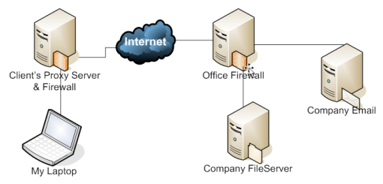
Proxies
Requests almost never are direct to server
Act as both a server and a client
Make requests on behalf of other clients
Act as firewalls or other roles

Slide 16
Structure of HTTP Messages
Request and responses have same basic format
Message header
Blank line
Message body
Blank line
Request starts with
METHOD /path-to-resource HTTP/version
Response starts with
HTTP/version status-code explanation

Slide 17
Structure of HTTP Messages
Simple example
http://cs.cegep-heritage.qc.ca/projects/CES/index.aspx
Request translates as
GET /projects/CES/index.aspx HTTP/1.1
Host: cs.cegep-heritage.qc.ca
Response comes back as
HTTP/1.1 200 OK
Content-Type: text/html
Content-Length: 9842
<html>…</html>
Notes:
Do more complex example from whiteboard HD

Slide 18
Request Methods
GET
Simplest of the request methods
Does not have a body
Any parameters are sent as a query string in URL
POST
Has a body following the headers
Body contains parameters and form fields
GET and POST behave differently depending on the receiving application
Notes:
Think about what happened on a form when there was a post vs. a get. Some of you had the problem in the lab with the form and the get vs. post
Do example in Whiteboard HD
http://www.unb.ca/rdc/index.html (with image inside)
Other methods are
HEAD (just get headers back and not body);
PUT (replaces target resource with uploaded content);
DELETE (Remove current representation of URI);
CONNECT (Establish connection tunnel);
OPTIONS (Return or set communication options);
TRACE (loop-back test along the path to the target);

Slide 19
Examples
http://www.fuzzy.me/folder1/folder2/mypage.html

Slide 20
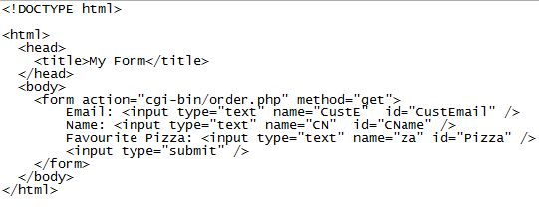
Example 2-4
At URL: www.mypizza.com
File: getpizza.html in folder pages

Slide 21
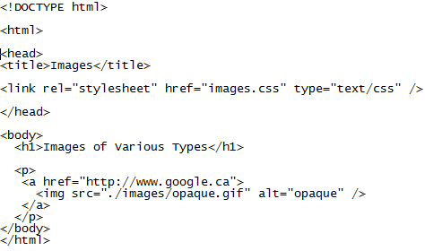
Example 5
At URL: www.mysite.ca
File: images.html in root folder

Slide 22
Status Codes
Number it starts with determines category
1 – informational
2 – successful response (200)
3 – tells the client to redirect (301 – URL change)
4 – client request errors (404 – page not found)
5 – server errors (500 – internal server error)
Notes:
Content is evolving. No need to put GET on two lines with new standard. Include everything on one line
Content-Type is changing too: text/javascript is obsolete and being replaced by application/javascript, but there is not universal support for it yet

Slide 23
Web Servers
Web servers enable HTTP access to a collection of documents and other information organized into a tree structure
Provide static content and pass requests to custom applications to provide dynamic content
Many ways to get dynamic data based on different standards
JSP, PHP, Cold Fusion, ASP, Ruby on Rails

Slide 24
Basic Web Server Operation
Servers receive and interpret HTTP requests
Locate resources
Generate responses
Return responses
Networking module receives requests and sends responses
Address resolution
Request processing
Response generation

Slide 25
Steps in Processing a Request
Request arrives at server to Networking Support module
Request passed to Address Resolution module
After resolution and authentication request is passed to Request Processing module
Control passes to the Response Generation Module
Response is passed to Networking Support module
Response is sent back to requestor
Notes:
Show picture on White board

Slide 26
Address Resolution Module
Pre-processing done to the request
Virtual Hosting: if the web server provides service for multiple domains, determine which domain is being referenced
Address Mapping: figure out where to get the information on the server
Authentication: If resource is protected, check credentials to make sure request is authorized

Slide 27
Delivering Static Content
Static content page
Static files containing HTML pages, XML pages, plain text, images, etc
HTTP responses must be constructed
As-is page
File containing complete HTTP responses including the headers

Slide 28
Delivering Dynamic Content
CGI – Common Gateway Interface
First and most common for a long time
Spawns a separate process for each request received (very Unix)
Based on a fixed set of environment variables
Often implemented in Perl
Script is called as form action from web page
Data must be decoded by server application before processing
Quite a simple method

Slide 29
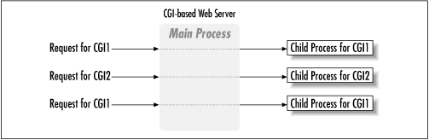
CGI Processing

Slide 30
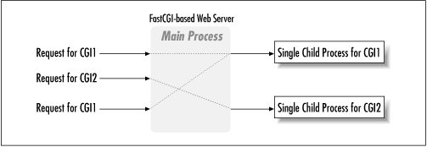
More Common Dynamic Methods
FastCGI
Portability of CGI with efficiency of APIs
Does not spawn new process, but runs on web server
Notes:
Advantages is disadvantages of each. Ask class about what they think…

Slide 31
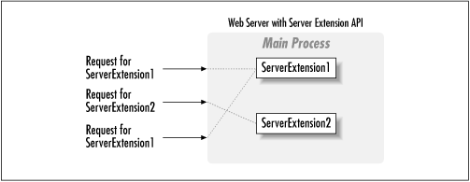
More Common Dynamic Methods
Servlet Extension APIs (ISAPI and Apache API)
Reside right on top of web server and have hooks into web server
PHP server is an example
Notes:
Advantages is disadvantages of each. Ask class about what they think…

Slide 32
More Common Dynamic Methods
Template Processing
Use additional tags on top of HTML
PHP, ASP, Cold Fusion, Java Beans

Slide 33
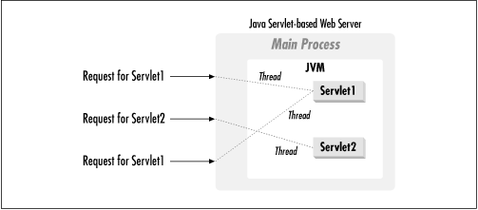
More Common Dynamic Methods
Servlet API
Stays running so it is faster/Portable across servers
Provide methods to get parameters and help in processing
Java Server Pages
Uses Servlet APIs with Template processing
Use Java base classes in web pages

Slide 34
Execution
HTTP server (web server) is a set of processes or threads
Some listen on designated ports
Some dedicated to processing requests
Number of threads determined by load on server
Has to resolve the address into physical address
Has to figure out what handler to use based on extension

Slide 35
Server Security
Need to secure the server, but not too much
Make sure you are only running the processes you need
If no FTP users, stop FTP and close port 25
Only provide access needed
If HTTP and FTP have the same access, then someone can use FTP to write a malicious executable to HTTP directory
Notes:
Talk about bank exposure

Slide 36
More Server Security
Use SSL connection
Configure a Firewall to only have certain ports open
Do NOT run HTTP web server on same machine as Firewall
Use HTTP Proxy with the Firewall
Protects the server behind the firewall
Does no processing, only routes requests to specific ports
Difficult to penetrate to where the real processing happens
Notes:
Why not run Firewall and HTTP server together?
One exposes the other
Fighting for same resources

